Slide 1
Restaurant Review Team JERM
JEBIN TASNIM(14.01.04.056)
REDWANUL FERDOUS(14.01.04.058)
Muntasir mamoor(14.01.04.072)
Fatin noor anik(14.01.04.073)

Slide 2
ENTITY-RELATIONSHIP DIAGRAM (ERD)
Graphical representation of an information system.
Shows the relationship between people, objects, places, concepts or events within that system.
ERD is a data modeling technique.
Helps to define business processes.
Can be used as the foundation for a relational database.

Slide 3
ENTITY SET NAMES
Rent
Customer
Owner
Car
Route Name
Package

Slide 4
Attributes with data types
Attributes of Rent:
Rent_Id int(11)
Package Id varchar(50)
Customer Id varchar(50)
Attributes of Customer:
Customer Id int(11)
Customer Name varchar(50)
Address varchar(50)
Customer Phone varchar(50)
Email varchar(50)
Password varchar(50)

Slide 5
Attributes with data types
Attributes of Car:
Car Id int(11)
Car Name varchar(50)
Model varchar(50)
OwnerId int(11)
Attributes of Owner:
Owner_Id int(11)
Name varchar(50)
Address varchar(50)
Phone int(11)
Email varchar(50)
Password varchar(50)

Slide 6
Attributes with data types
Attributes of Route:
RouteId int(11)
Source varchar(50)
Destination varchar(50)
Attributes of Package:
Package Id int(11)
Name varchar(50)
Price int(11)
Car_Id int(11)
RouteId int(11)

Slide 7
Attributes with Symbols
Simple Attribute:
Composite Attribute:
Derived Attribute:
Multivalued Attribute:
( )

Slide 8

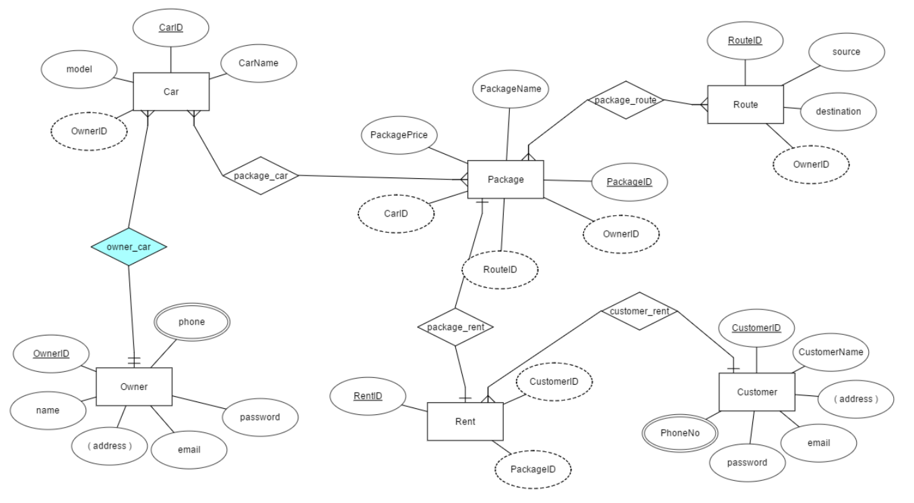
ENTITY RELATIONSHIP DIAGRAM (ERD)

Slide 9
CLASS DIAGRAM
A class is the description for a set of objects with the same attributes and operations.
Serves as a template for object creation.
Show visibility only on design models
Assess responsibilities on domain class diagrams
Highlight language-dependent visibility with property strings
Highlight types only on design models
Highlight types on analysis models only when the type is an actual requirement

Slide 10
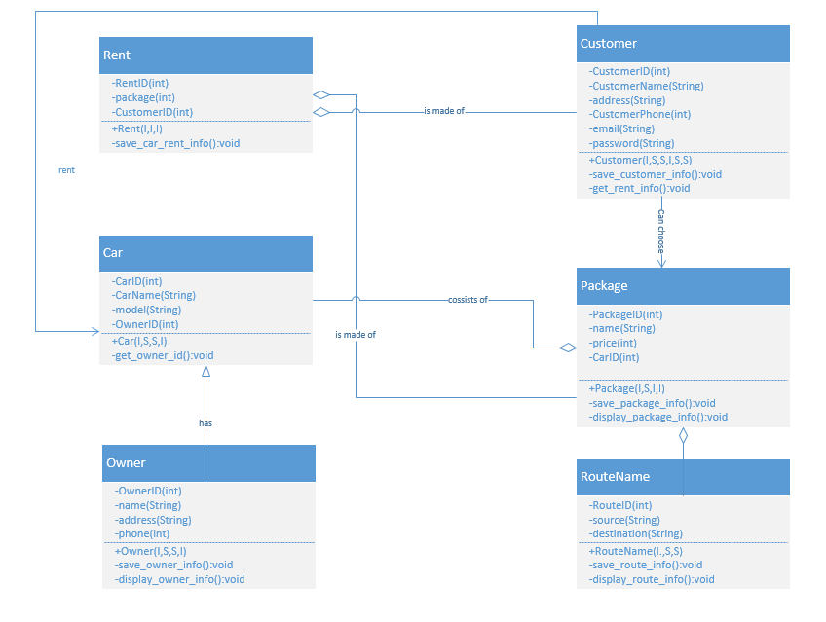
CLASS DIAGRAM

Slide 11
CONCLUSION
We will try our best to implement the project as the ERD and Class Diagram we have prepared.

Slide 12
THANK YOU

